Slide 1
SOF/C Tactical OPE Toolkit
MAY 12, 2025
SAIL-AI-TRAIN-2025

Slide 2
Agenda
Scenario
Problem Statement
Functional Requirements
Application Design
Design
Infrastructure Deployment
CI/CD Pipeline
Application Demo
Application Output Overview
Process and Cost Comparison
Future Development Considerations
Lessons Learned

Slide 3
Team Composition
Team Members - Dev Role:
Gregory McDonald - Vision Language Model
Haldon Franko - Deployment Infrastructure
Jeff Noland - Frontend
Maksym Kalinchenko - Google API
Sang Yim - App Output
Zachary Andersen - Large Language Model
AI2C Scholar and Mentors:
Eric Youn
Zach Murphy

Slide 4
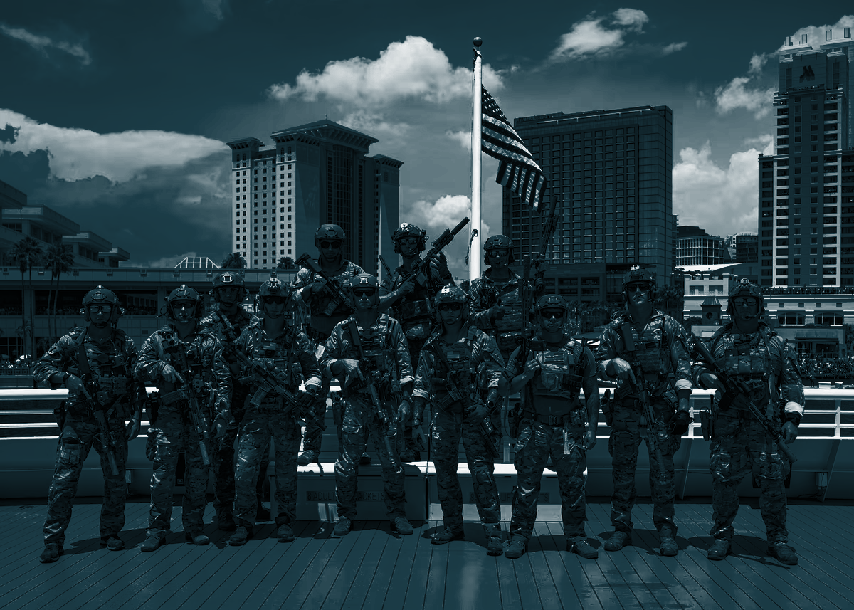
Special operations are those operations requiring unique modes of employment, tactical techniques, equipment and training often conducted in hostile, denied, or politically sensitive environments and characterized by one or more of the following: time sensitive, clandestine, low visibility, conducted with and/or through indigenous forces, requiring regional expertise, and/or a high degree of risk (JP 3-05)
What are Special Operations?

Slide 5
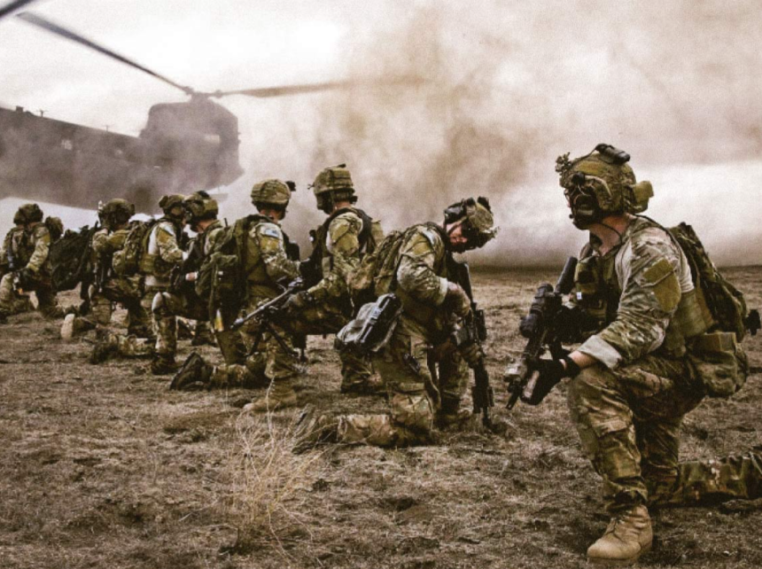
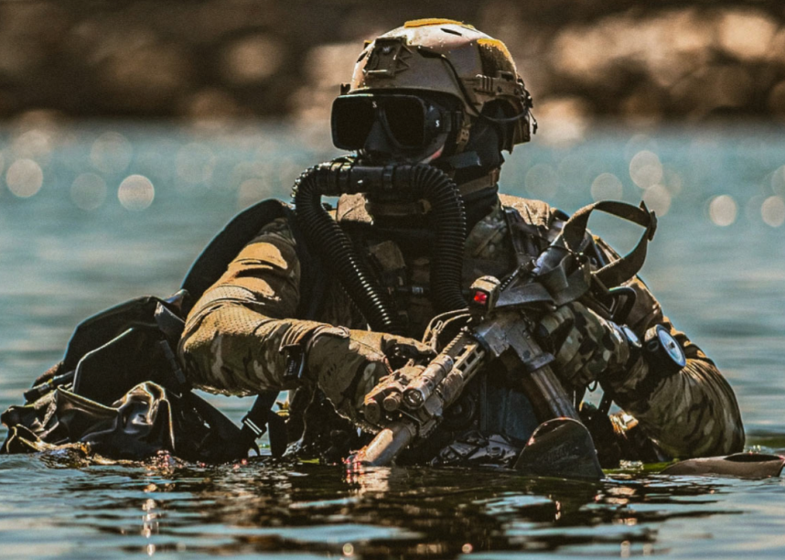
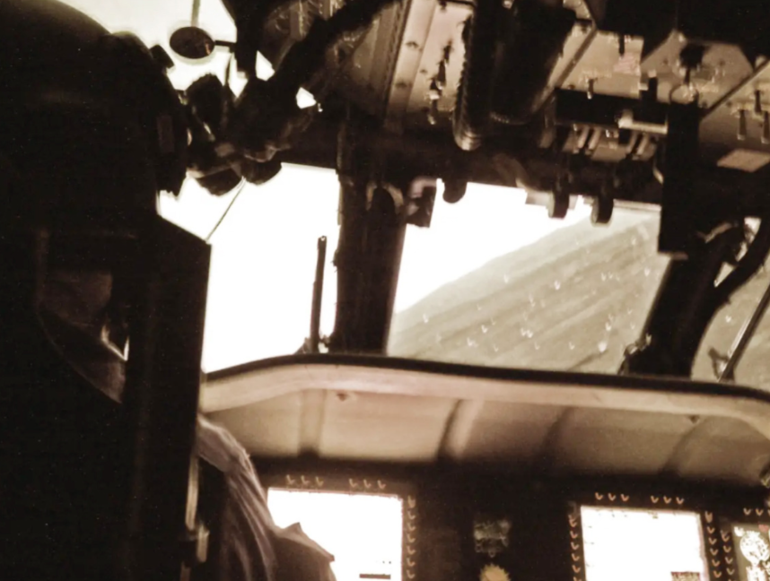
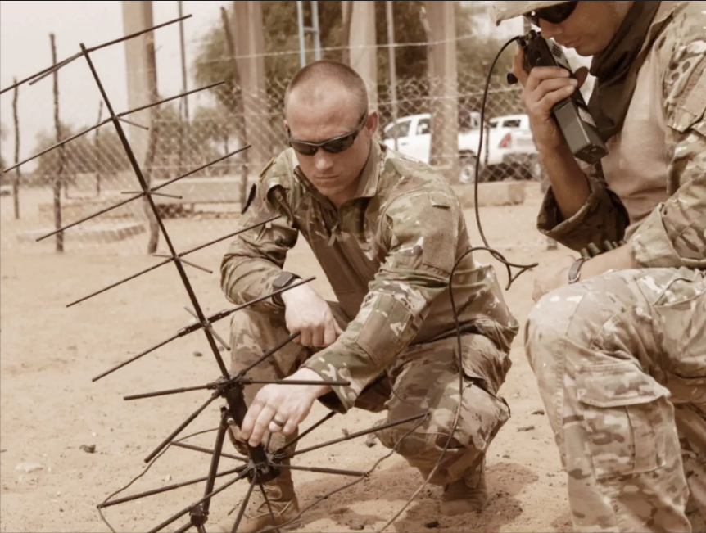

Who comprises U.S. Army Special Operations?
Rangers
Special Forces
Aviation Regiment
Psychological Operations
Civil Affairs

Slide 6
Operational Preparation of the Environment (OPE) is a non-intelligence activities and a series of activities that seek to enable future operations by allowing U.S. Department of Defense DOD personnel to enhance their situational awareness and understanding within an area of interest. (JP 3-13)
What is Operational Preparation of the Environment?

Slide 7
Problem Statement
How can we retrieve location details from Google Maps and generate an Excel, with image analysis and review summarization to enable operational planning and execution while reducing the man hours and cost?
Why is this a current manual solution a problem?
Time consuming - 8-40 hours on each excel - mission requires under 24 hours.
Inefficient - 20 minutes per location - our application will enable the workflow in two minutes = 90% reduction in schedule

Slide 8
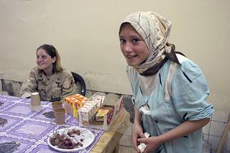
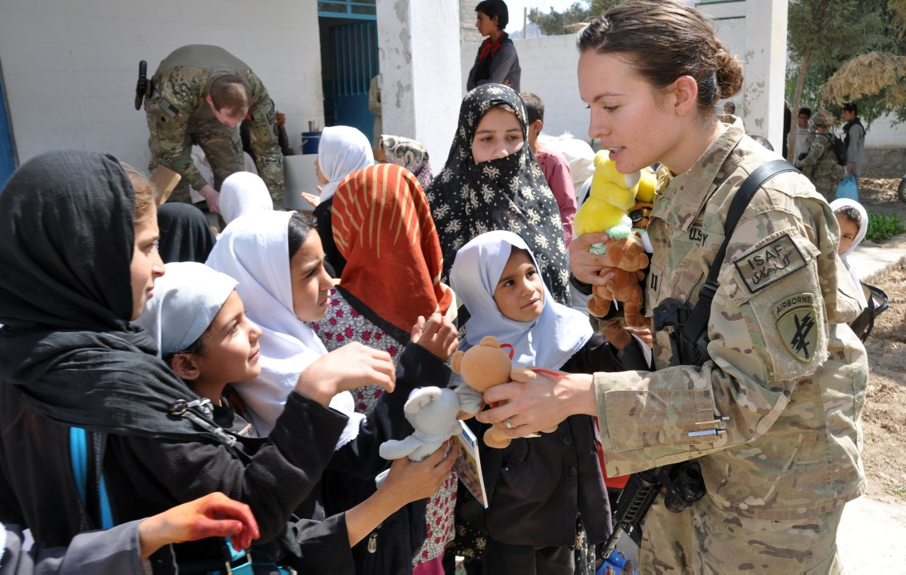
Demo Scenario - Civil Affairs
The Special Operations Forces Analyst will conduct OPE, using the Tactical OPE Toolkit, to identify Grocery Stores in Podil district of Kiev, Ukraine to support Civil Affairs Operations.

Slide 9
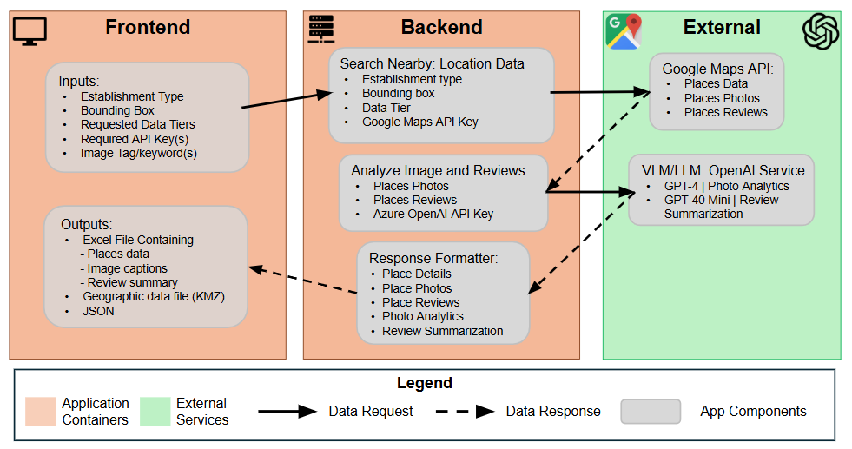
Functional Requirements & Application Design

Slide 10
Infrastructure Deployment
Cloud Deployment (Current State)
Azure Kubernetes Service (AKS)
Azure Container Registry (ACR)
API Gateway
CI/CD Pipeline
Scaling
  Vertical Testing using Locust.py, Apache JMeter
  Horizontal Pod Autoscaler
  Node Autoscaler
Monitoring Solution (Prometheus)
Local Deployment (Current State)
ReadMe
Download application code
Docker Desktop
Docker Compose.yaml
  Docker build
  Restarts
Monitoring Solution (Docker Desktop)

Slide 11
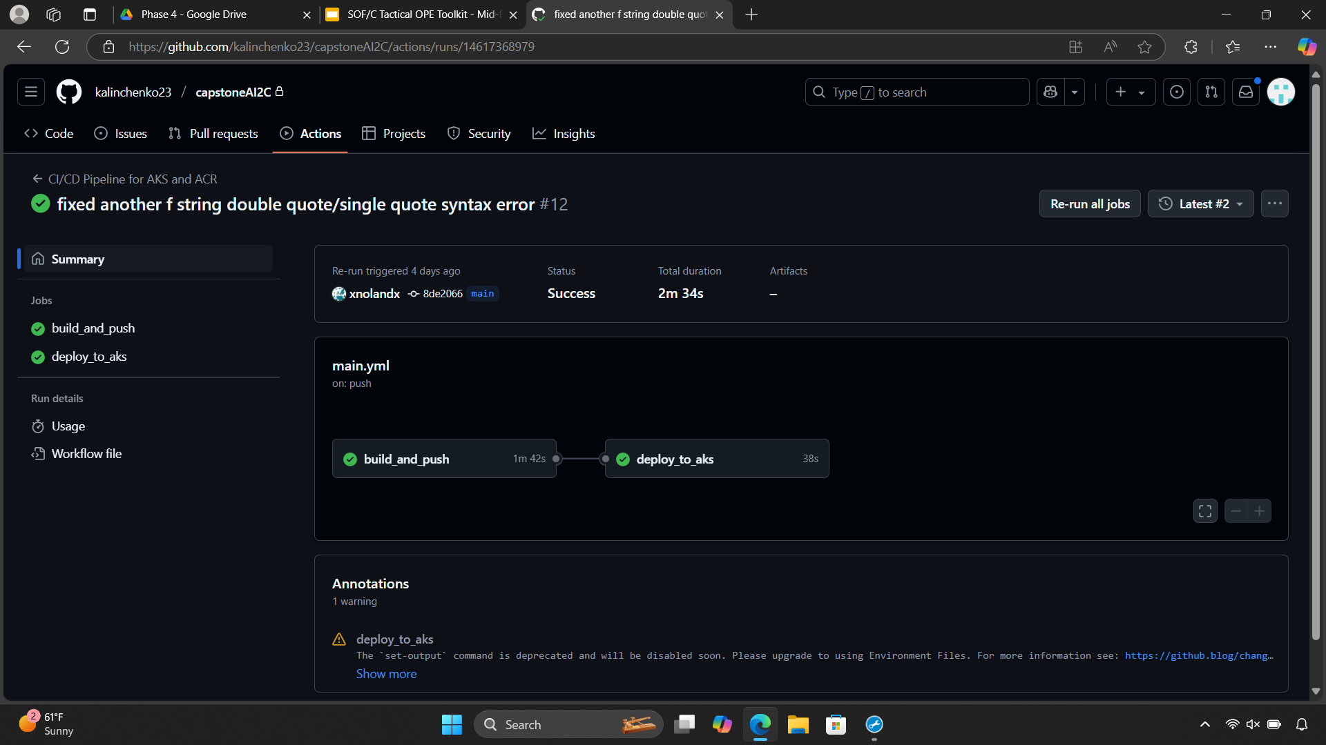
CI/CD Pipeline

Slide 12
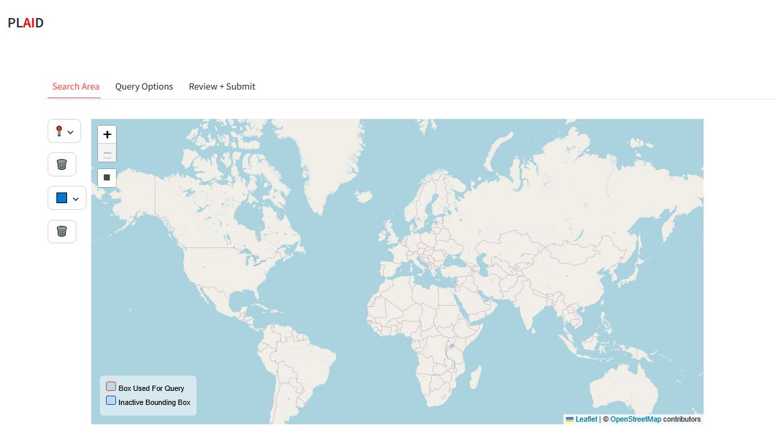
Frontend Demo

Slide 13
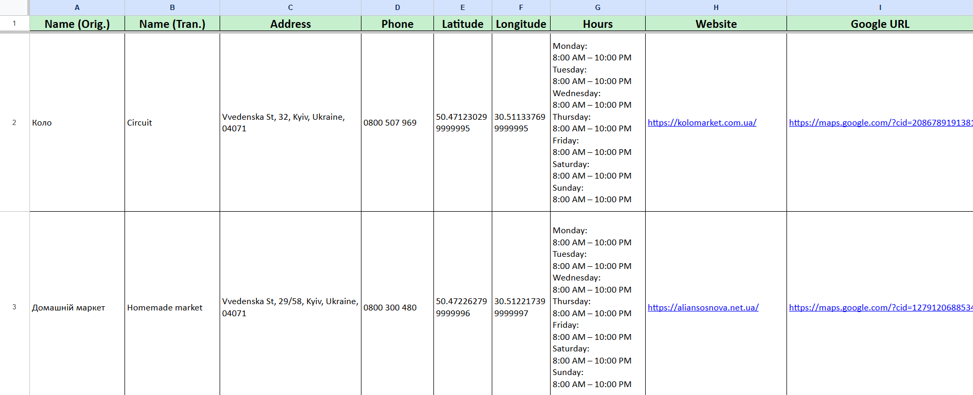
Output Demos

Slide 14
Process Improvement: Cost and Time Analysis per Month
Customer processes ~400 locations per month
Time reduction: 125 hours(94%)
Manual Process
App Estimate
Actual (Production)
Time: 133 hours
(20 minutes per location)
Time: 13 hours
(2 minutes per location)
Time: 8 hours
(1.2 minutes per location)
Cost: $37 =
Google Maps API $21, OpenAI API $16
Cost: $6,666.70 @ $50/hr
Cost: $208.00 (estimated fees)
Cost reduction: $6,629.70 (99%)
*Data assumes each location includes 5 reviews, 10 photos, 1 street view photo, and all data tiers selected.

Slide 15
Lessons Learned
Lack of initial detailed planning
Over-reliance on individual ownership of tasks
Tight budget restricted testing options

Slide 16
Future Challenges / Concerns
Long-Term Maintenance
Restricted Flexibility
Cost of Use the Application

Slide 17

Conclusion & Questions
SOF/C Tactical OPE Toolkit
Team Members
Gregory McDonald
Haldon Franko
Jeff Noland
Maksym Kalinchenko
Sang Yim
Zachary Andersen
AI2C Scholar and Mentors:
Eric Youn
Zach Murphy
For more information on the Tactical OPE Toolkit including a demonstration video and documentation - use the QR code

